Slide 1

Elevate Your Career
Digital Portfolio Templates
Presented by [Your Name Here]

Slide 2
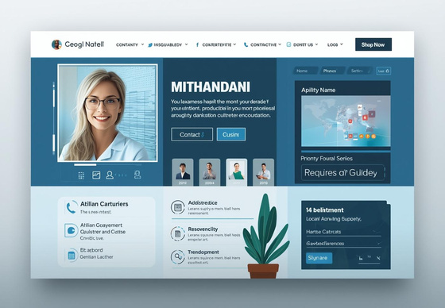
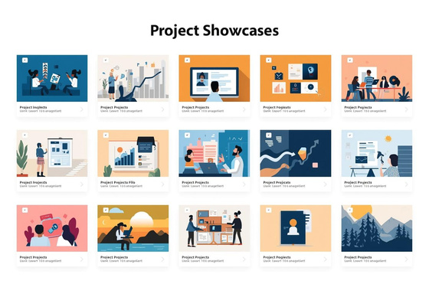
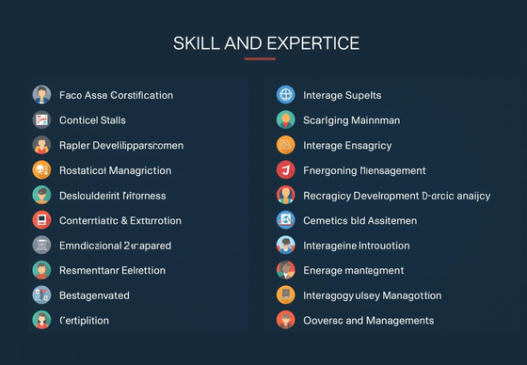
Essential Portfolio Components
Personal Introduction
A strong personal introduction highlights your expertise and invites connections in a professional context.
Personal Introduction & Showcase
Showcase of Work
Highlighting standout projects effectively demonstrates your skills and achievements to potential employers or clients.
Skills and Expertise
Presenting your skills clearly with endorsements builds credibility and enhances appeal to prospective audiences.
NOTES AND OBSERVATIONS
2

Slide 3

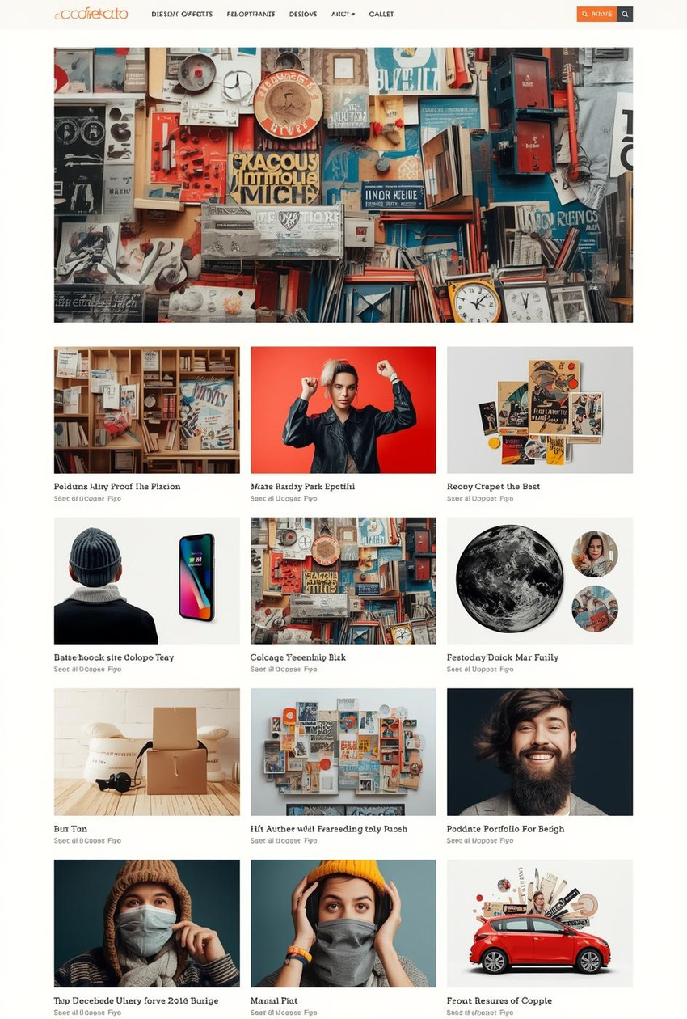
Consistent Branding
Good vs. Poor Design Examples
DESIGN INSIGHTS
3

Slide 4
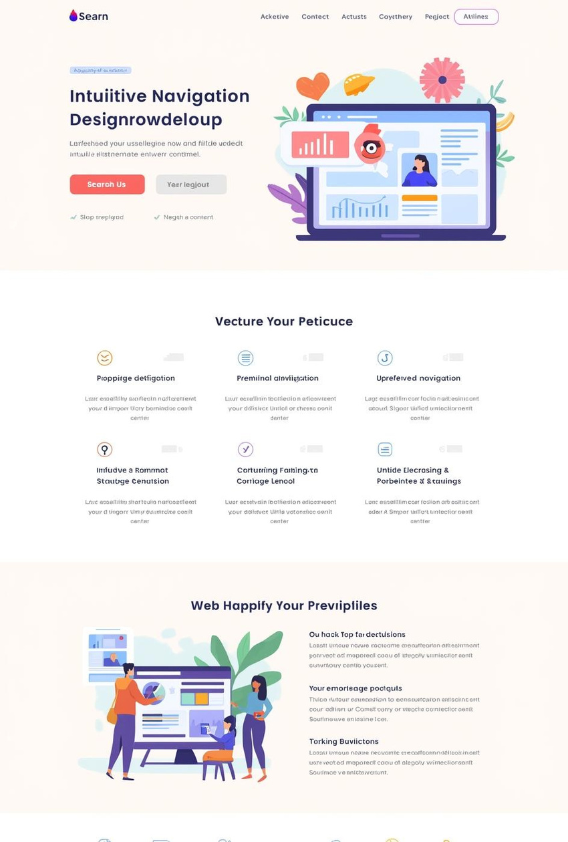
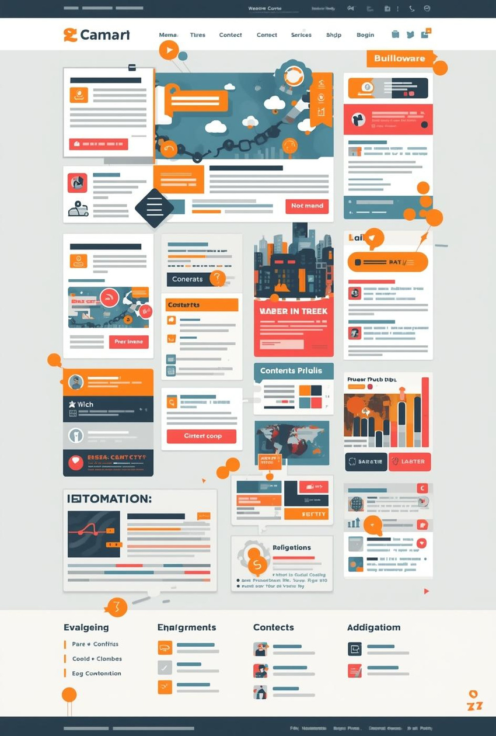
Design Principles
Intuitive Navigation: Good vs. Poor
NOTES
4

Slide 5
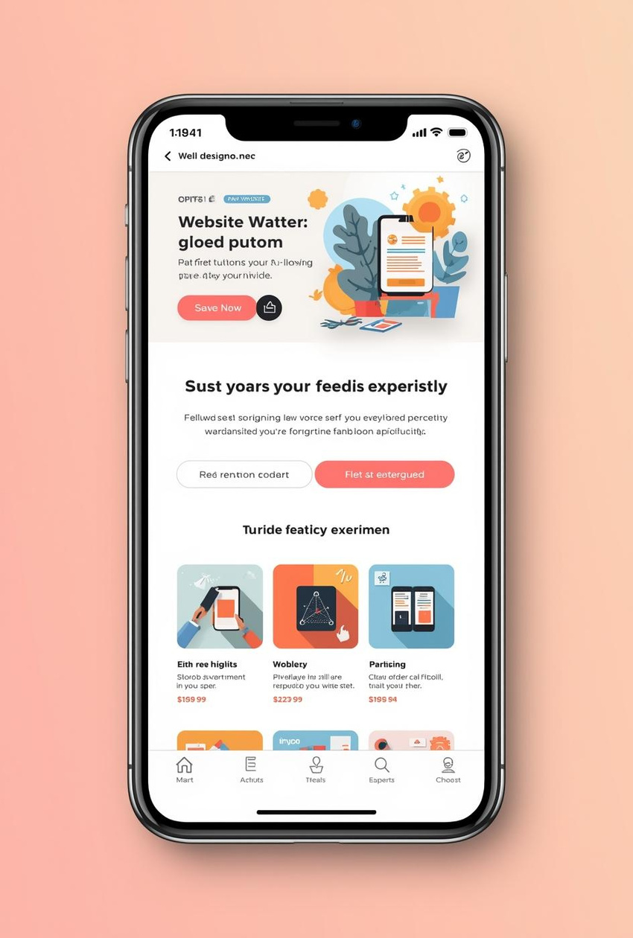
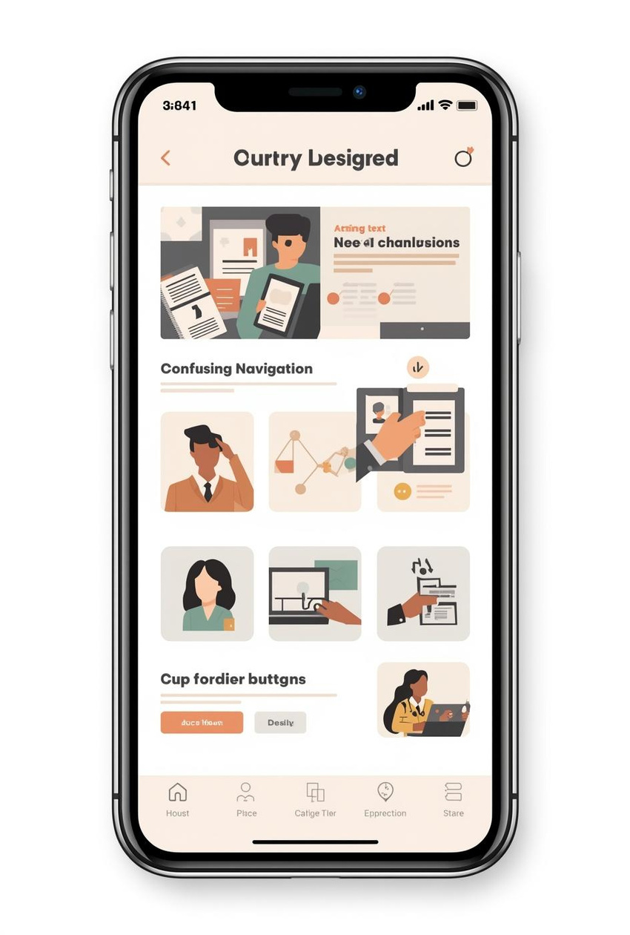
Design Principles
Mobile Responsiveness: Good vs. Poor
NOTES
5

Slide 6
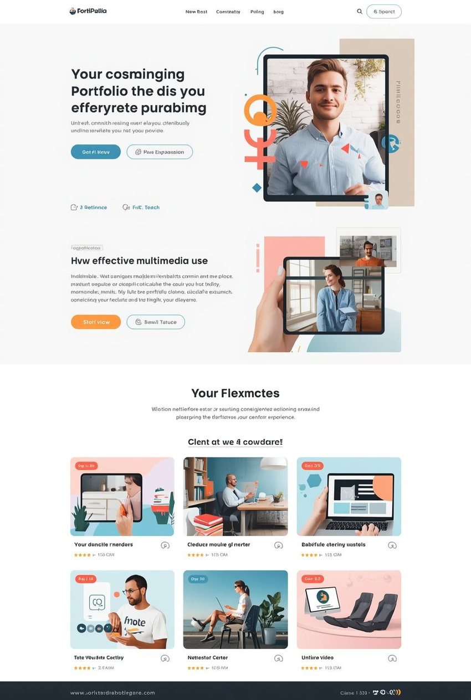
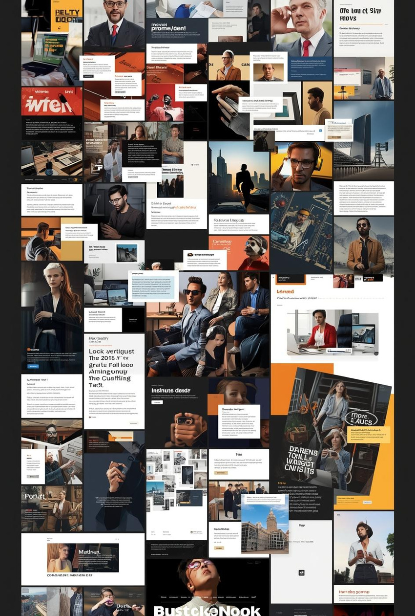
Design Principles
Effective Multimedia Use: Good vs. Poor
CONSIDERATIONS FOR DESIGN
6

Slide 7
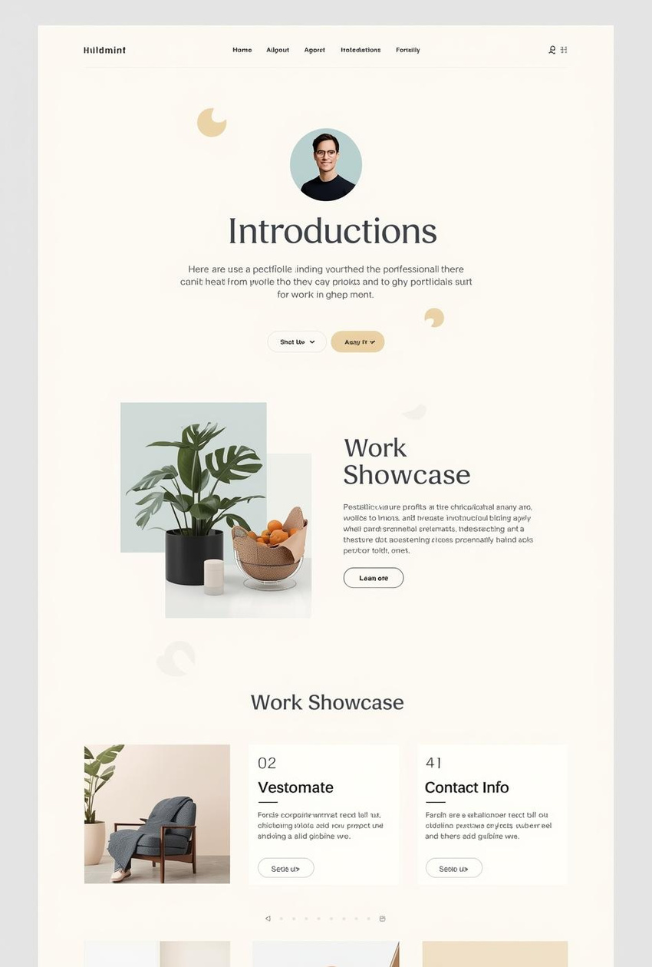
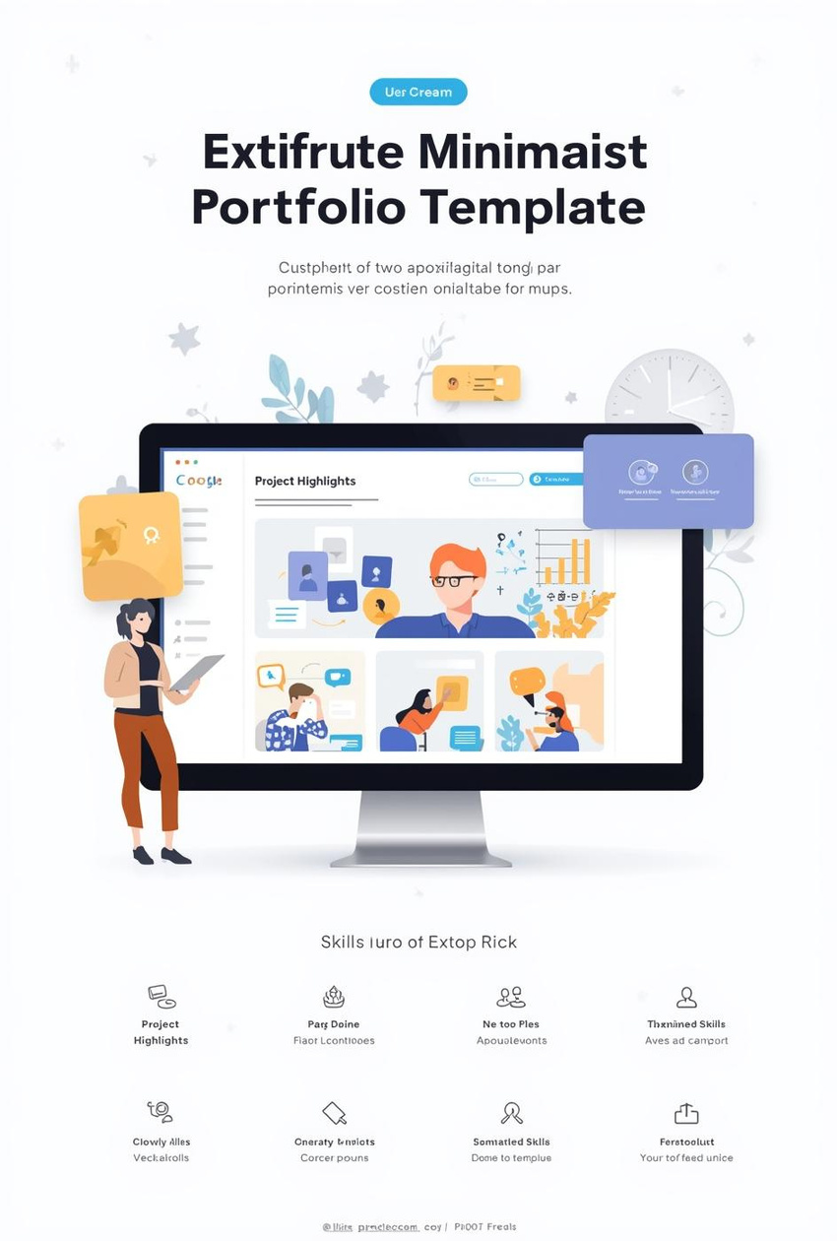
Minimalist Template
Clarity and Simplicity for Professionals
KEY FEATURES
7

Slide 8
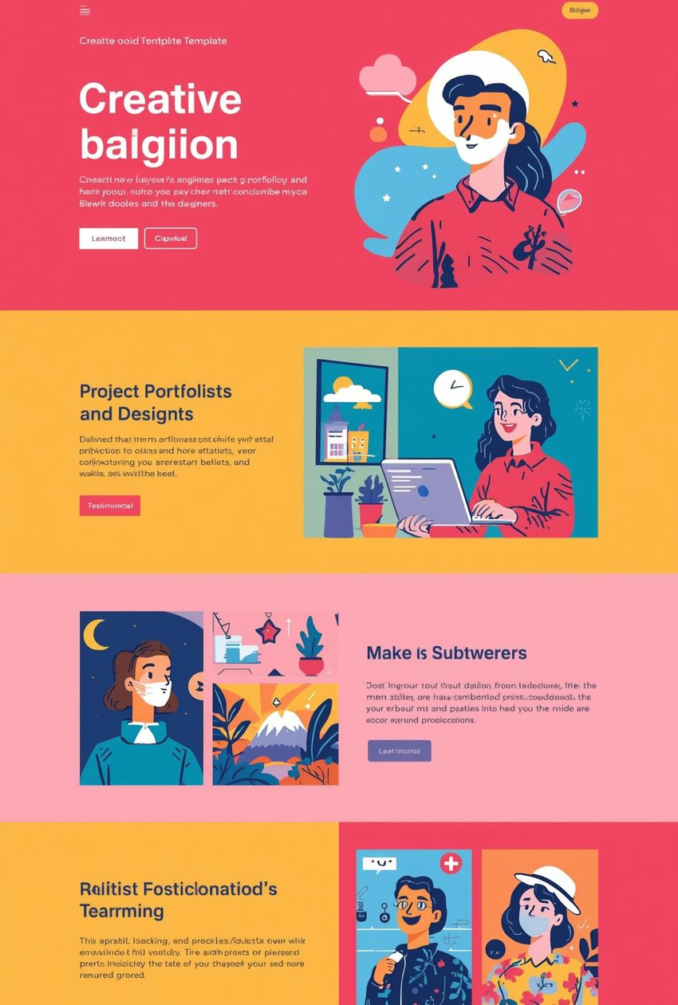
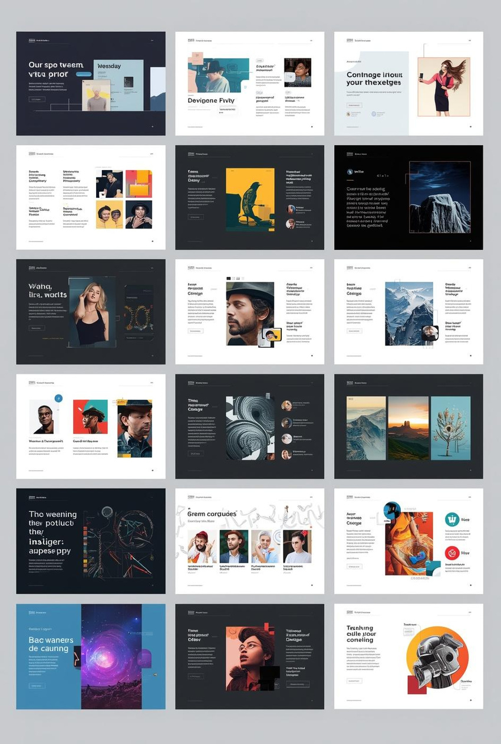
Creative Template
Engaging Design for Creative Professionals
EXAMPLES AND INSIGHTS
8

Slide 9
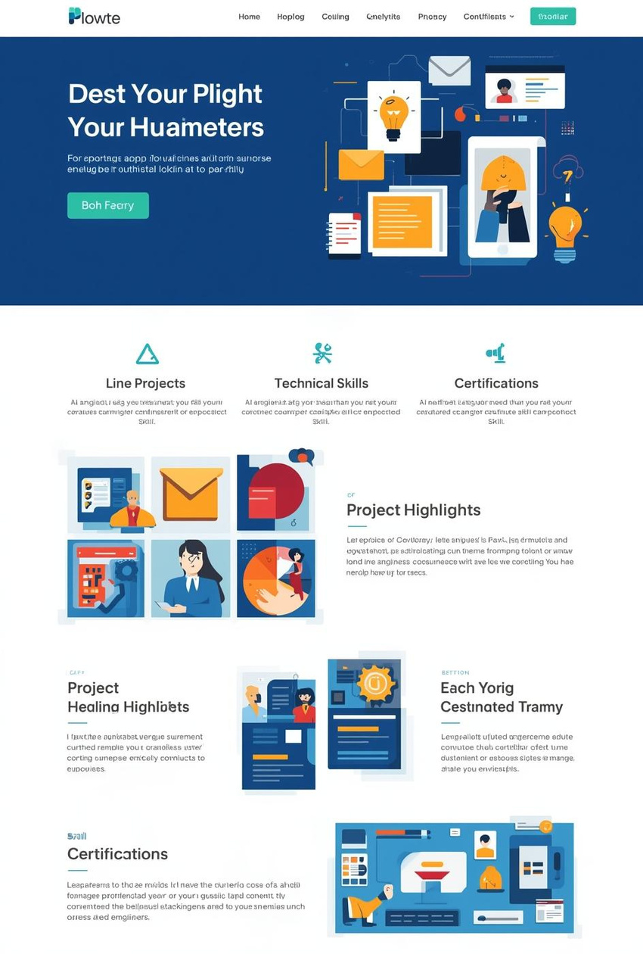
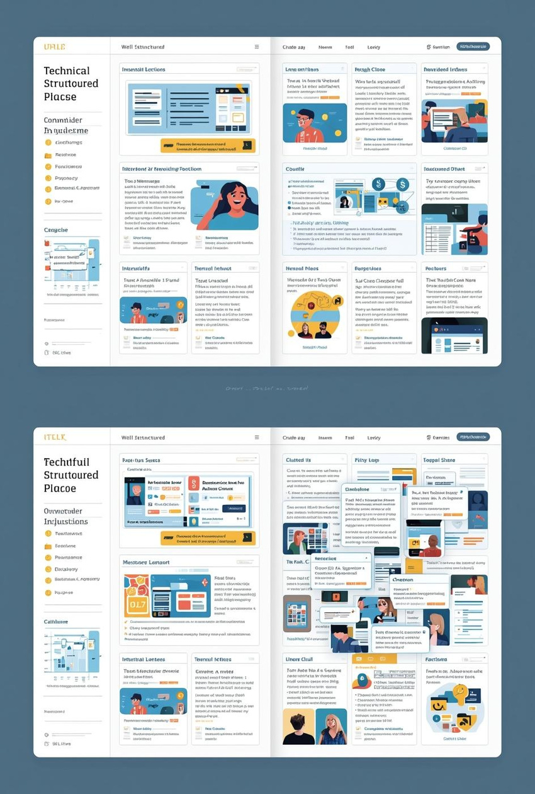
Technical Template
Digital Portfolio for Engineers and Developers
KEY FEATURES
9

Slide 10
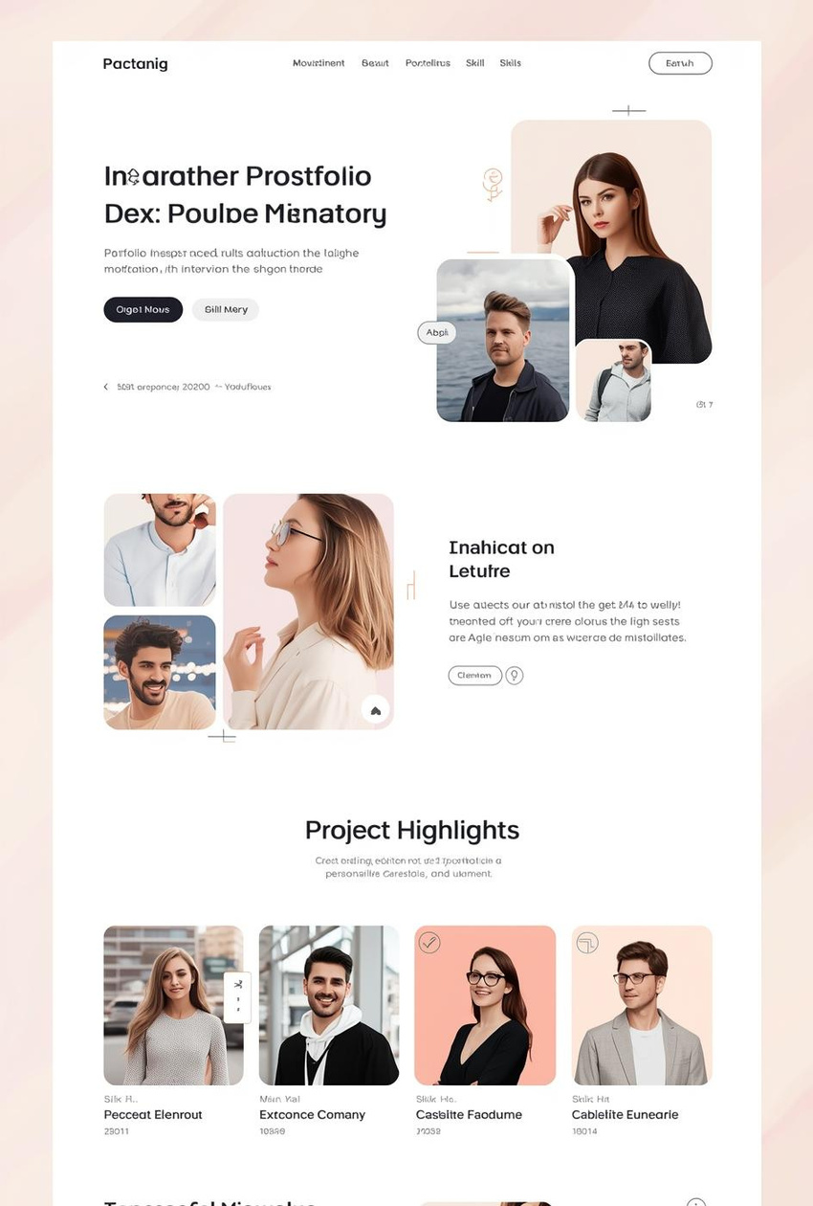

Hybrid Template
Balanced Approach to Professional Portfolios
NOTES
10

Slide 11

Next Steps
Regularly update and tailor content
A well-maintained digital portfolio showcases current skills and experiences. Tailoring your portfolio to reflect target audiences enhances relevance and engagement, allowing you to stand out in your field.
NOTES AND TIPS
11

Slide 12

Contact Information
We're here to help!
Phone
123-456-7890
Email
hello@reallygreatsite.com
Website
www.reallygreatsite.com

